Slide 1
Cooking & Order Analytics
By INDUMATHI

Slide 2
Objective
Analyze user behavior, cooking preferences, and order trends.
Provide actionable insights to enhance operational efficiency and revenue.
Develop data-driven recommendations for growth.

Slide 3
Workflow
Extract data/import data
Transform data(Remove blank and duplicates)
Manage Relationships
KPI and Visualization
Dashboard

Slide 4
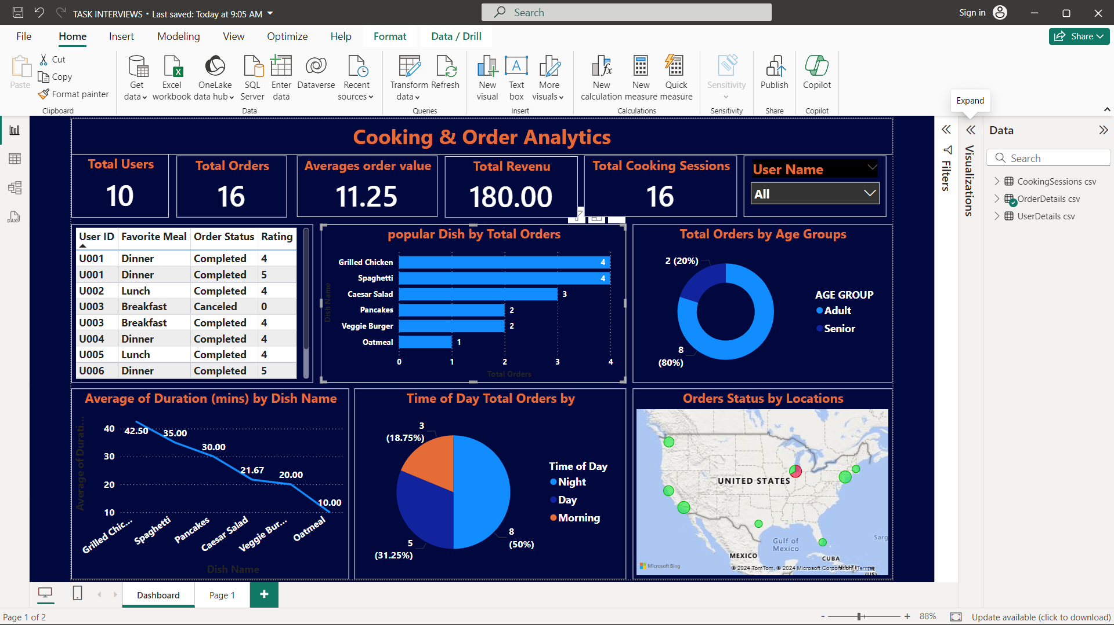
DASHBOARD

Slide 5
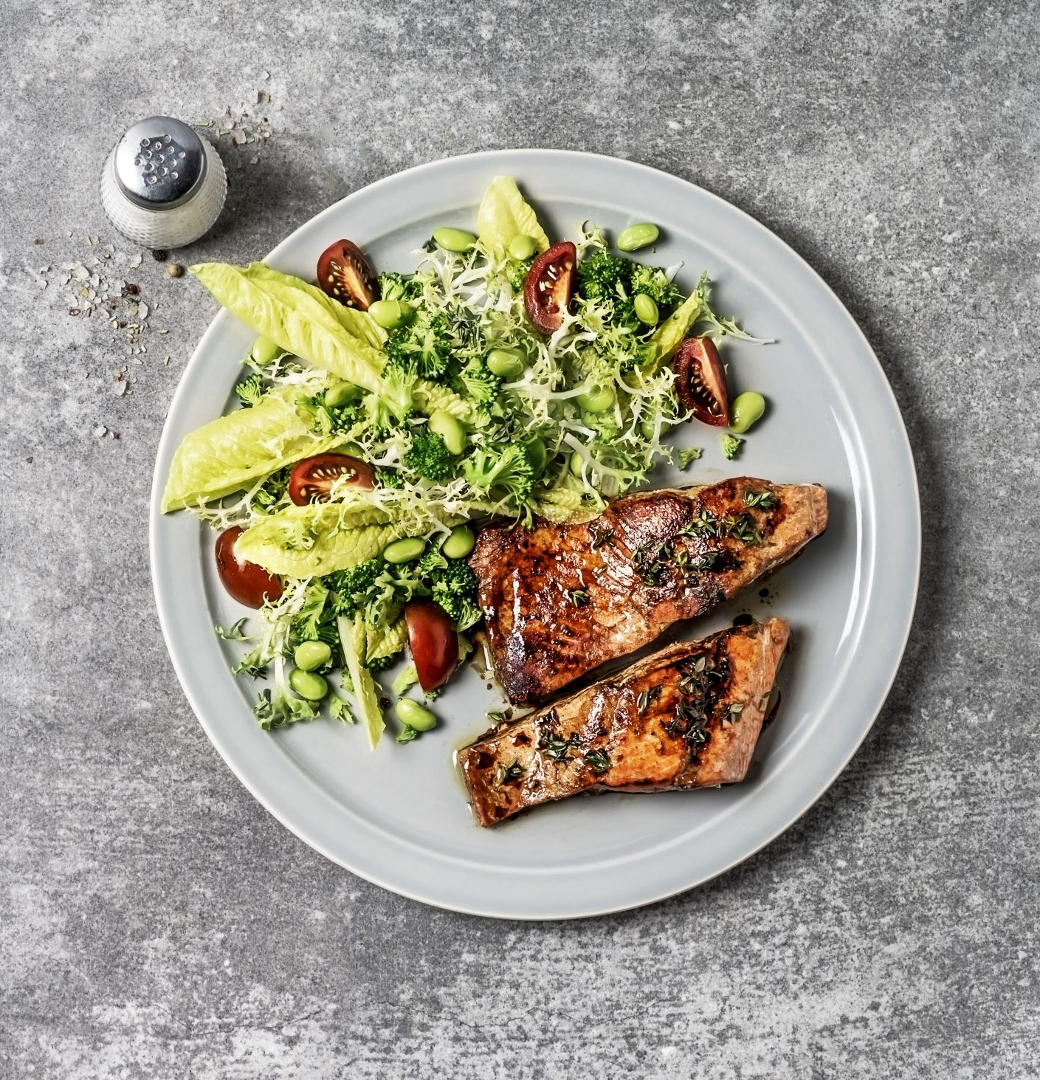
Insights
Popular Dishes: Grilled Chicken and Spaghetti lead in orders; Veggie Burger and Oatmeal lag behind.
Order Trends by Age Group: Adults dominate (80%), while seniors are a smaller segment (20%).
Time of Day: Daytime (50%) sees the highest orders; nighttime (18.75%) is the least active.
Cooking Times: Grilled Chicken and Spaghetti take the longest to prepare, while Oatmeal is the quickest.

Slide 6

Recommendations
Popular Dishes: Promote signature dishes and gather feedback on underperforming ones.
Targeting Demographics: Design campaigns for adults and senior-friendly options.
Time-Based Promotions: Offer nighttime deals and boost daytime loyalty programs.
Operational Efficiency: Streamline prep times for long-duration dishes.
Revenue Growth: Implement upselling strategies to increase average order value.

Slide 7
Conclusion
Key Insights Identified: Metrics like popular dishes, time-based order trends, and customer demographics have been analyzed to highlight opportunities.
Recommendations Developed: Actionable strategies for marketing, efficiency, and customer engagement were proposed to boost growth.
Next Steps: Implement these recommendations, monitor results, and refine strategies based on ongoing data analysis.

